Slide 1
Convolutional codes
Tomashevich Victor

Slide 2
Introduction
Convolutional codes map information to code bits sequentially by convolving a sequence of information bits with “generator” sequences
A convolutional encoder encodes K information bits to N>K code bits at one time step
Convolutional codes can be regarded as block codes for which the encoder has a certain structure such that we can express the encoding operation as convolution

Slide 3
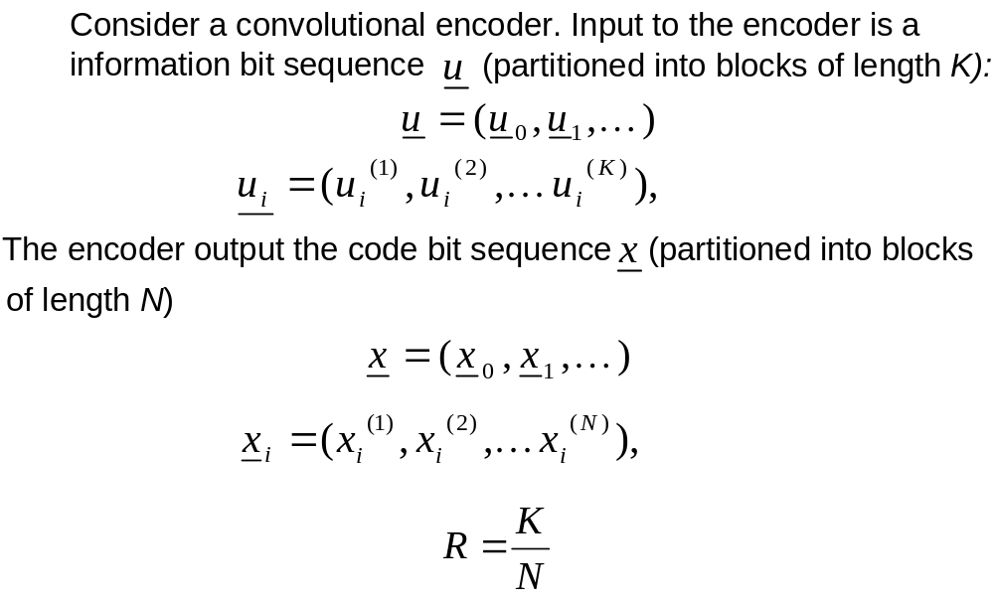
Properties of convolutional codes

Slide 4
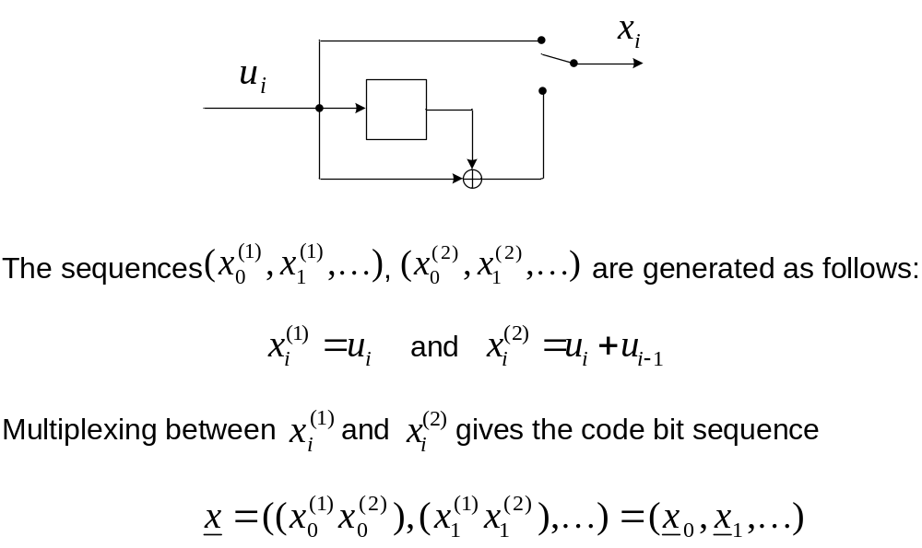
Example: Consider a rate ½ convolutional code with K=1 and N=2 defined by the circuit:

Slide 5
The convolutional code is linear
The encoding mapping is bijective
Code bits generated at time step i are affected by information bits up to M time steps i – 1, i – 2, …, i – M back in time. M is the maximal delay of information bits in the encoder
Code memory is the (minimal) number of registers to construct an encoding circuit for the code.
Constraint length is the overall number of information bits affecting code bits generated at time step i: =code memory + K=MK + K=(M + 1)K
A convolutional code is systematic if the N code bits generated at time step i contain the K information bits

Slide 6
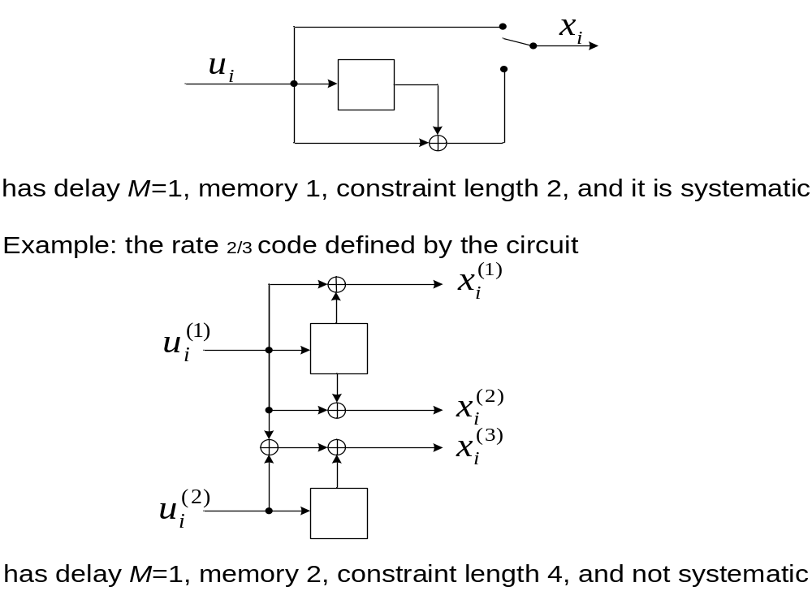
Example: The rate ½ code defined by the circuit

Slide 7
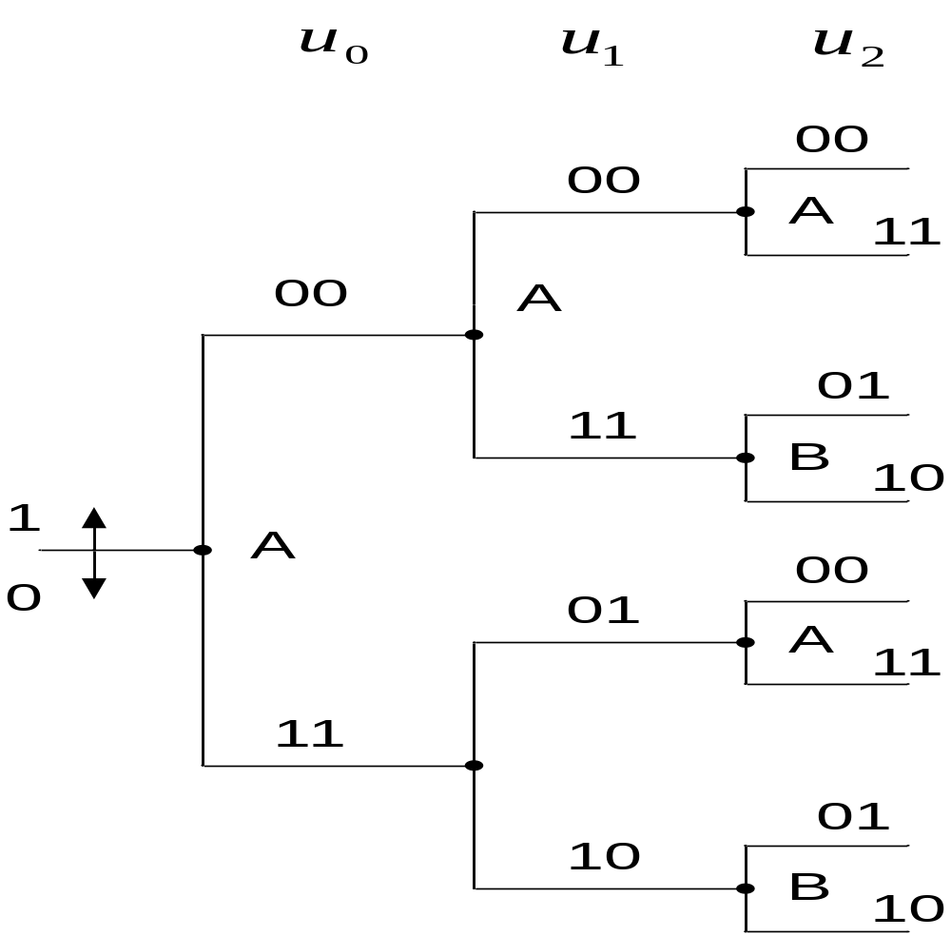
Tree

Slide 8
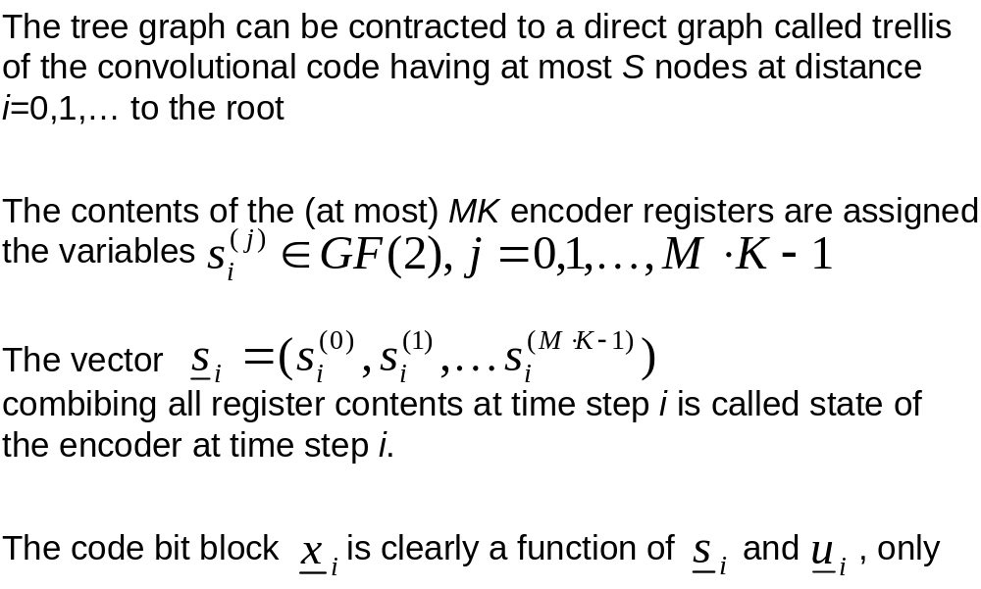
Trellis

Slide 9
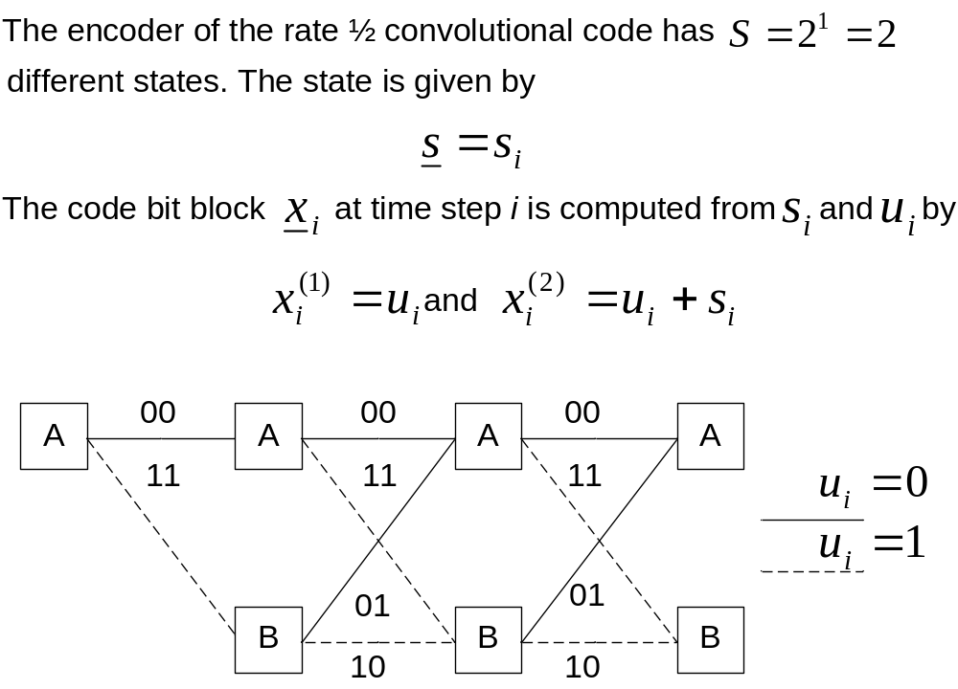
Example:

Slide 10
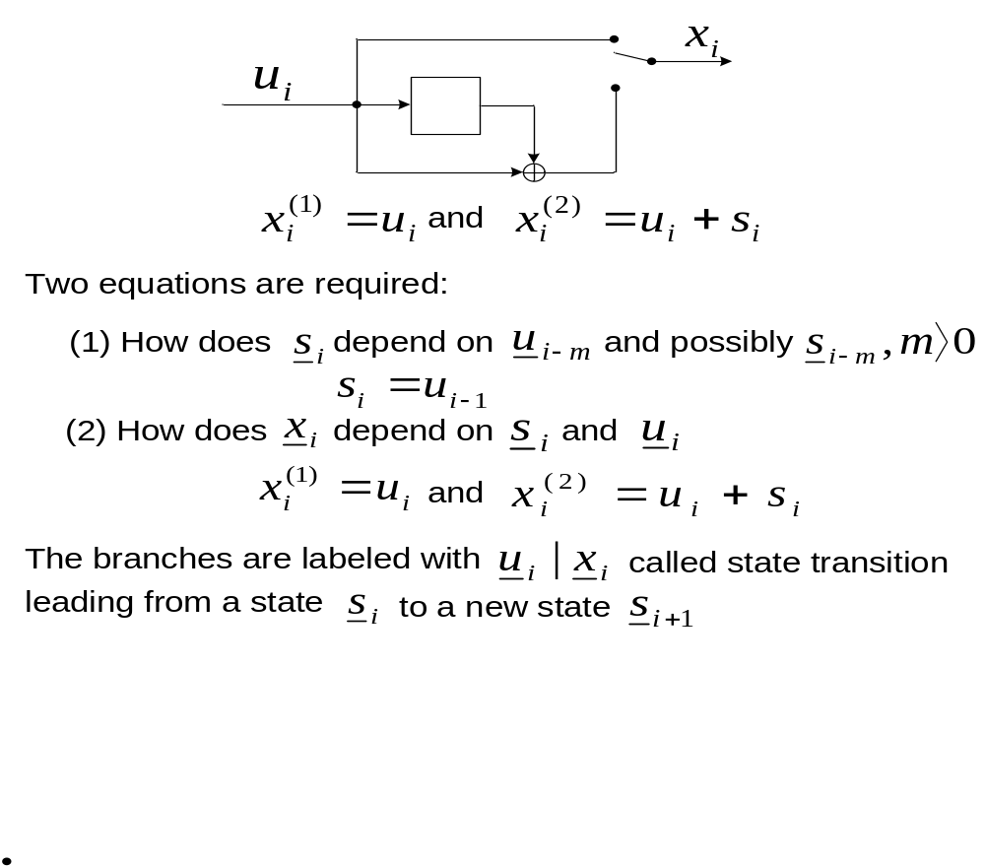
Example: Constructing a trellis section

Slide 11
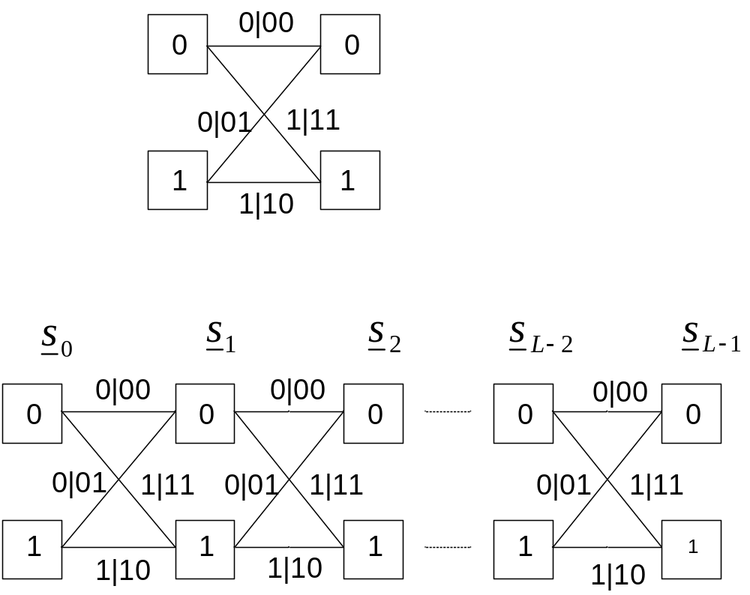
Trellis section:

Slide 12
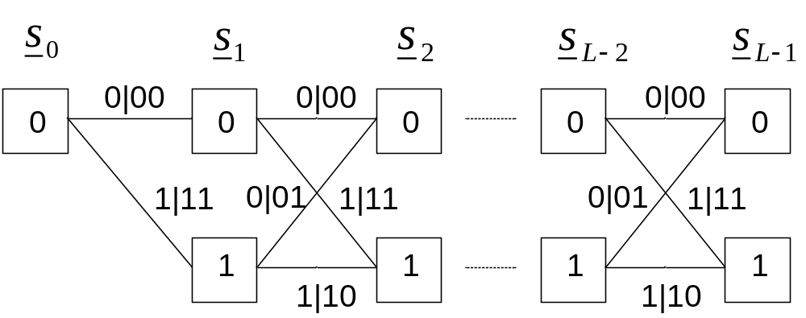

Slide 13
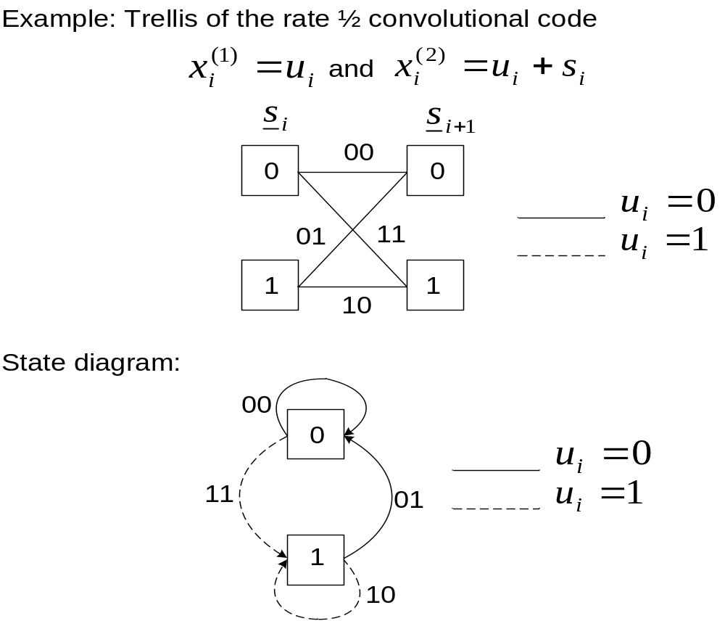
State diagram

Slide 14
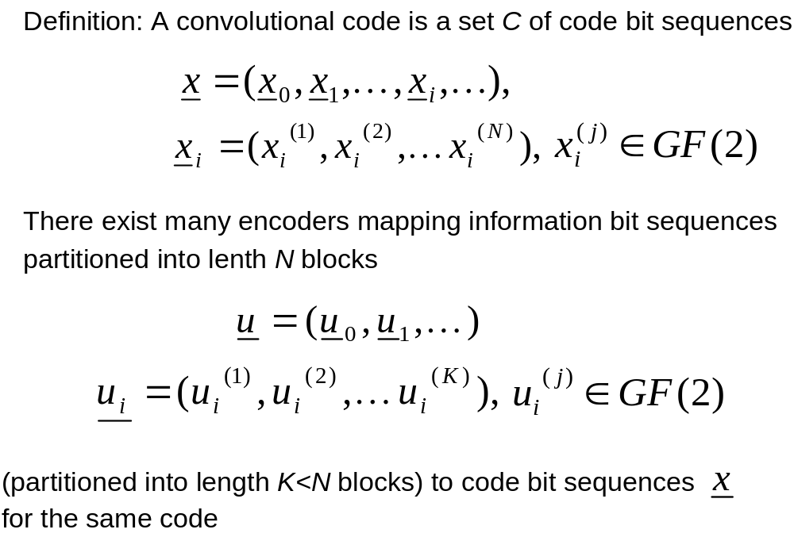
Description with submatrices

Slide 15
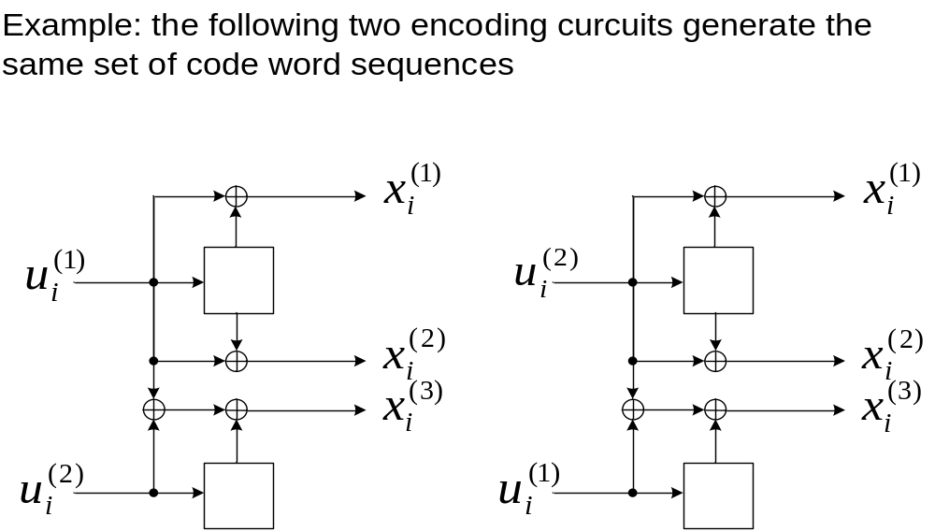

Slide 16
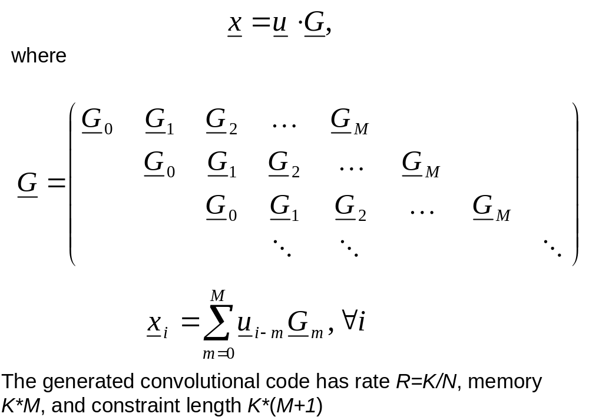
Generator matrix

Slide 17
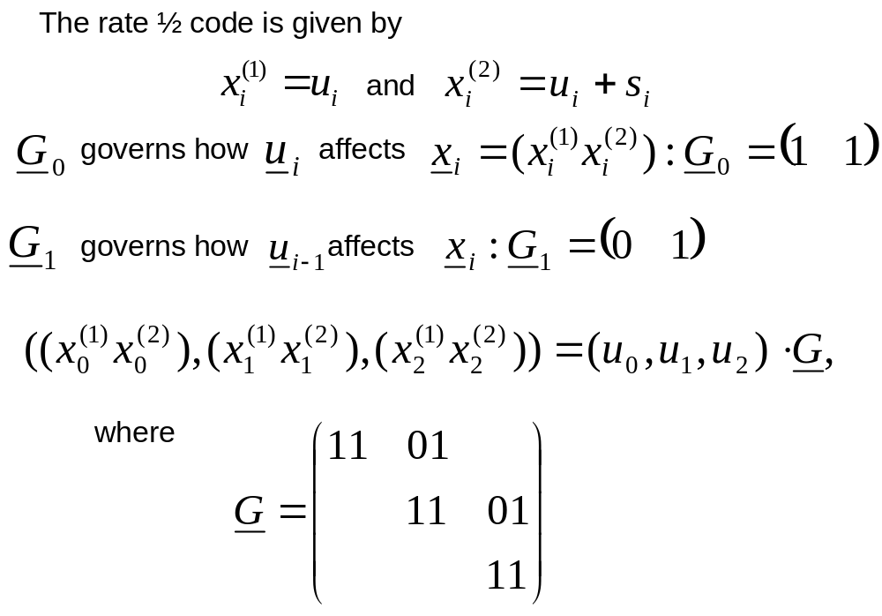
Example:

Slide 18
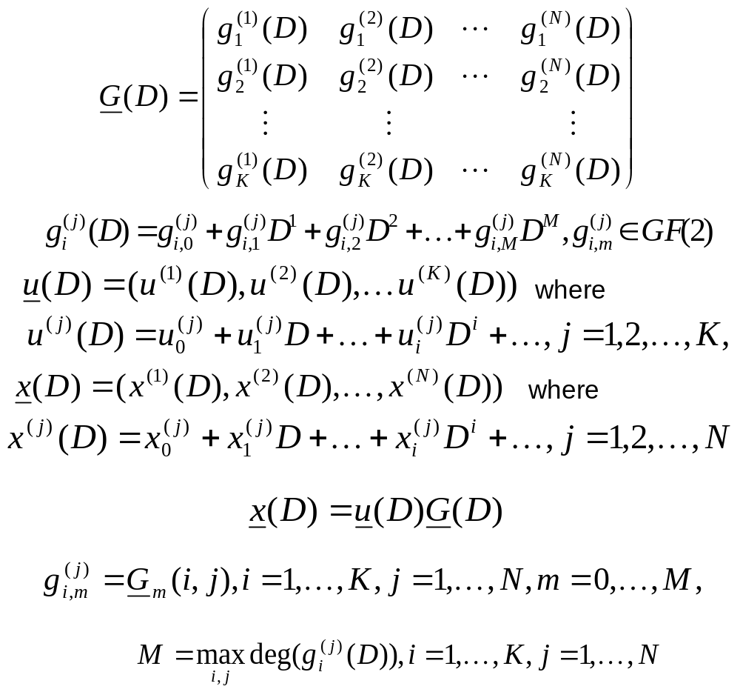
Description with polynomials

Slide 19
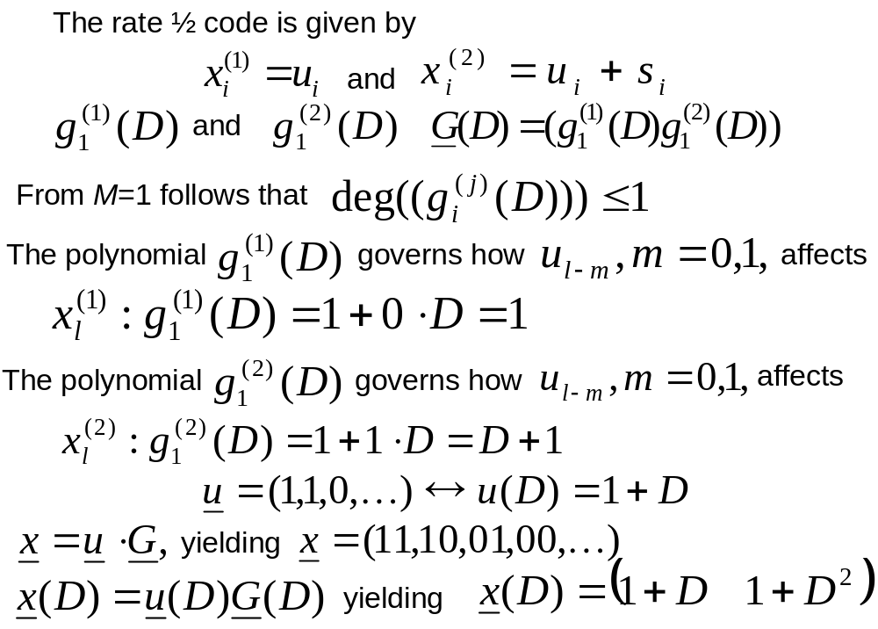
Example:

Slide 20
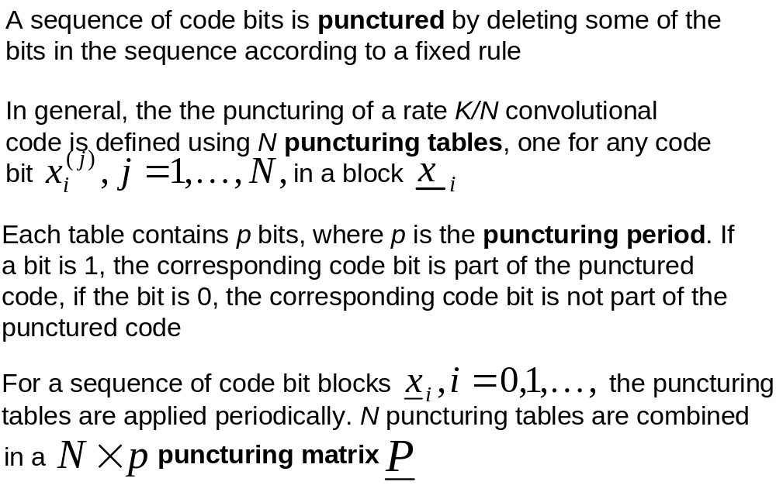
Punctured convolutional codes

Slide 21
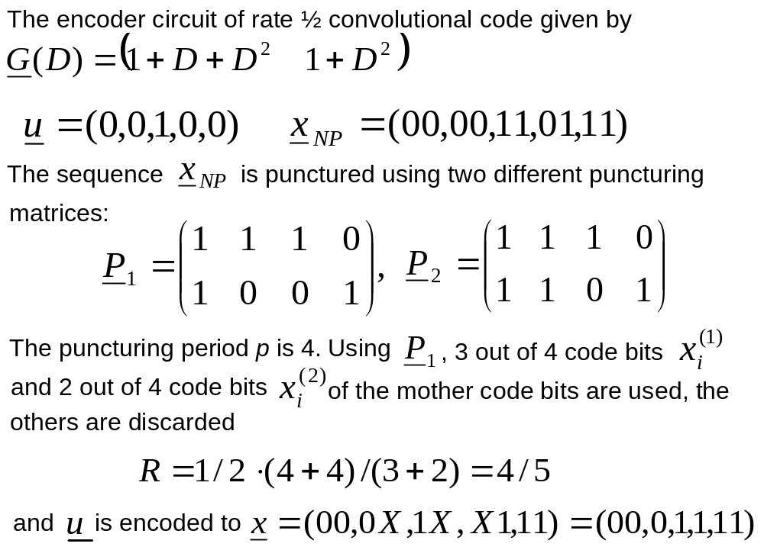
Example:

Slide 22
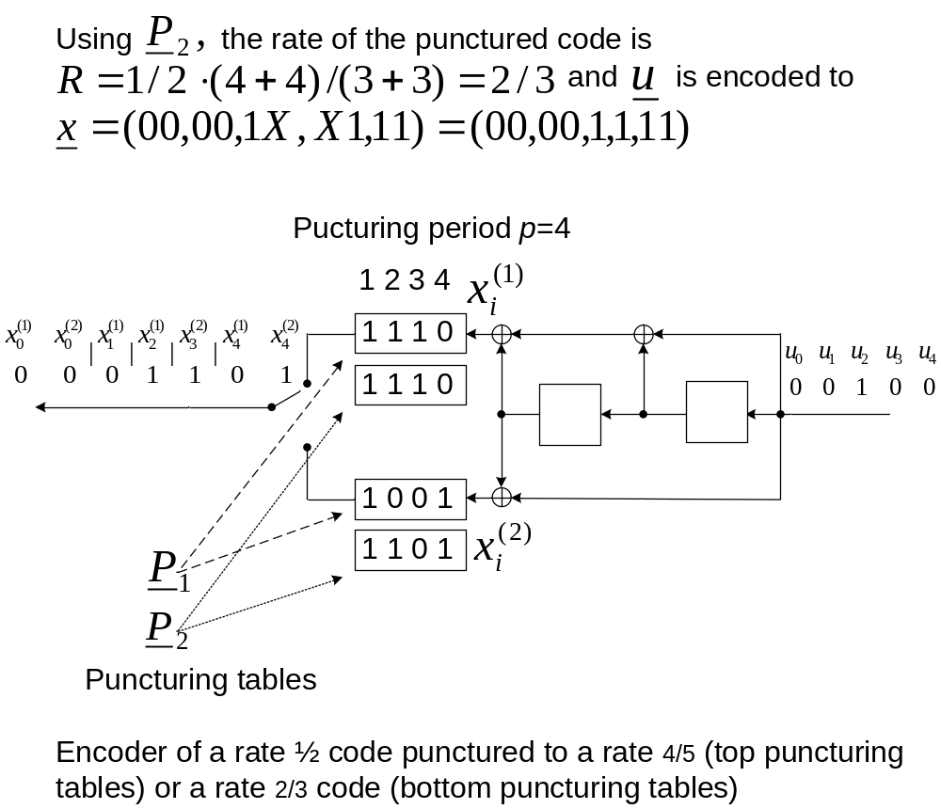

Slide 23
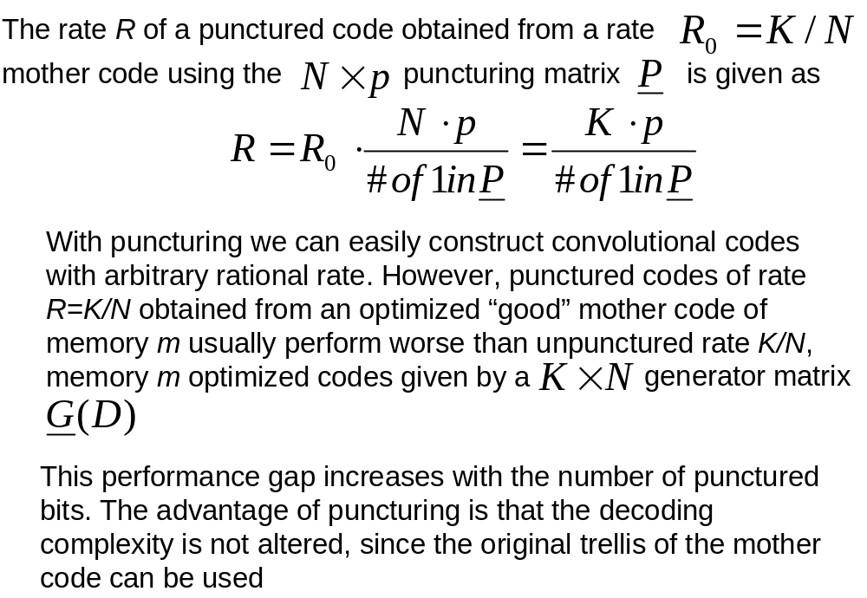

Slide 24
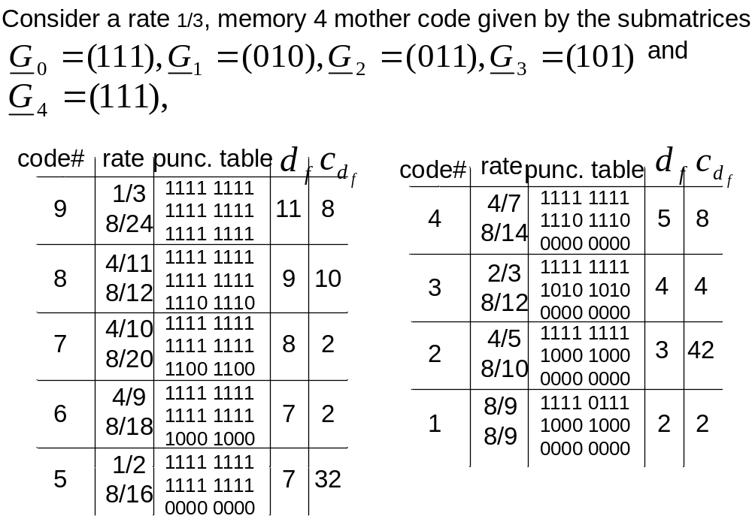

Slide 25
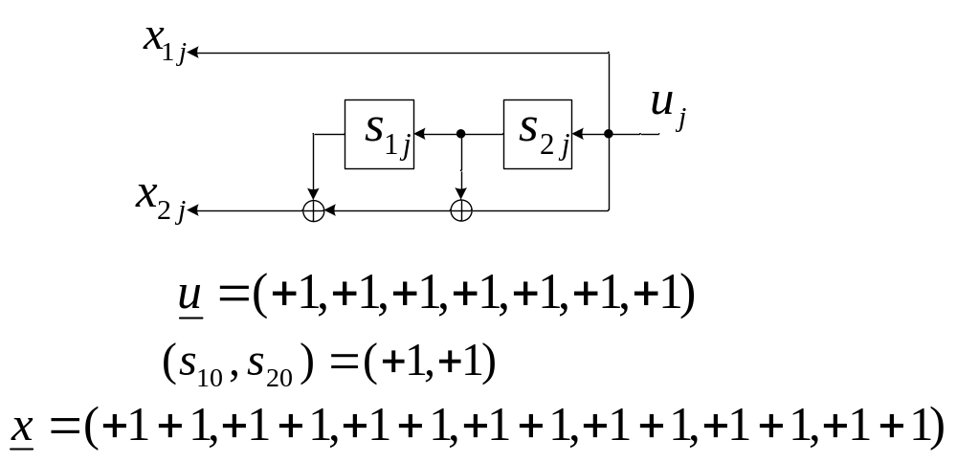
Decoding of convolutional codes
The Viterbi algorithm

Slide 26
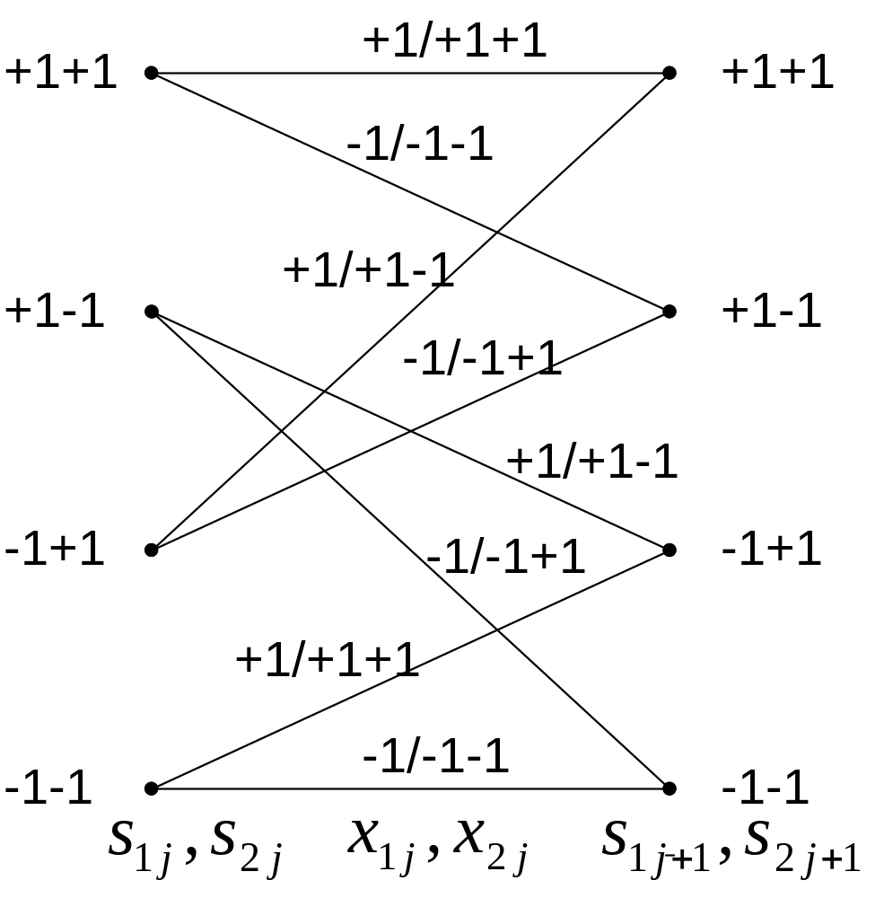

Slide 27
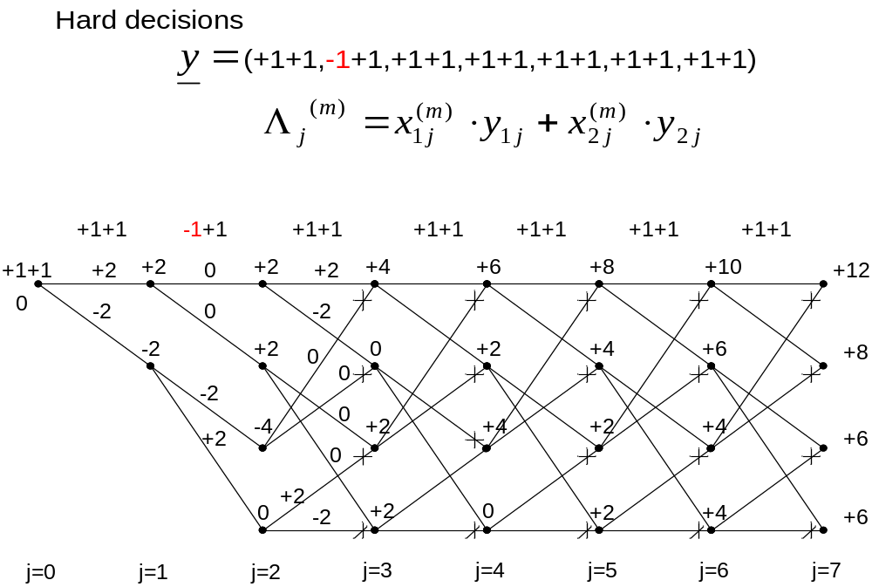

Slide 28
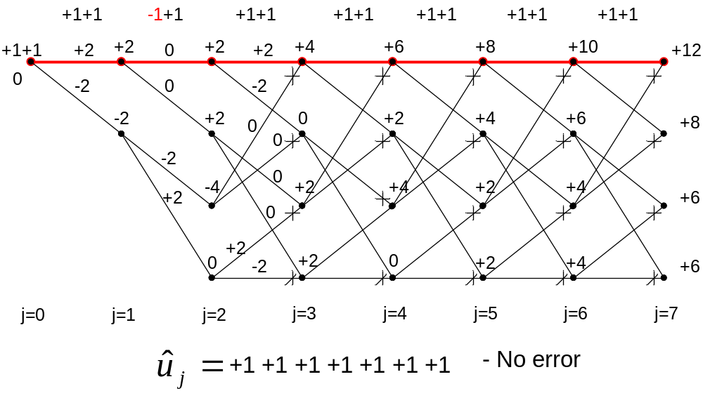

Slide 29
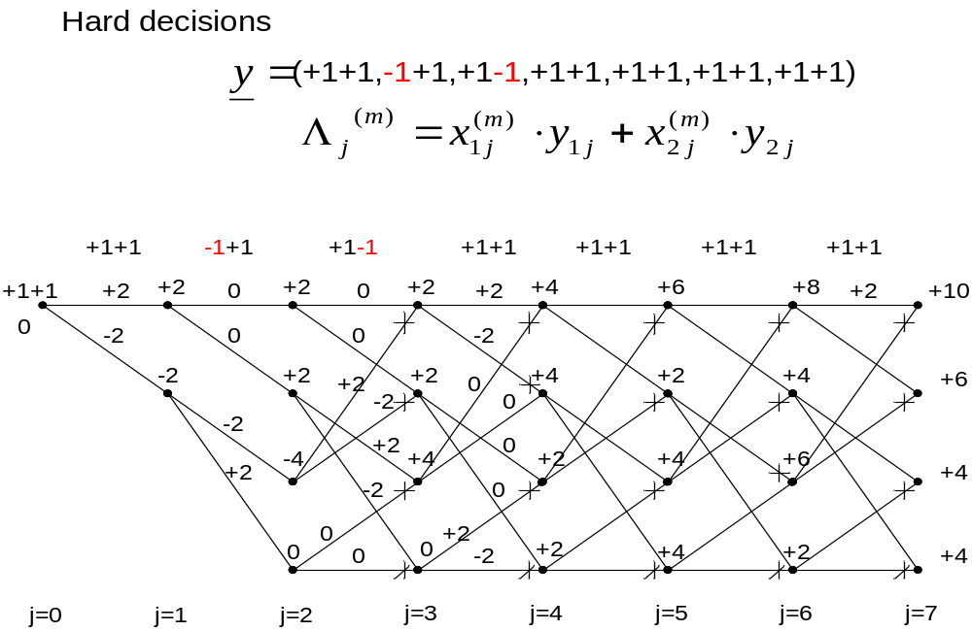

Slide 30
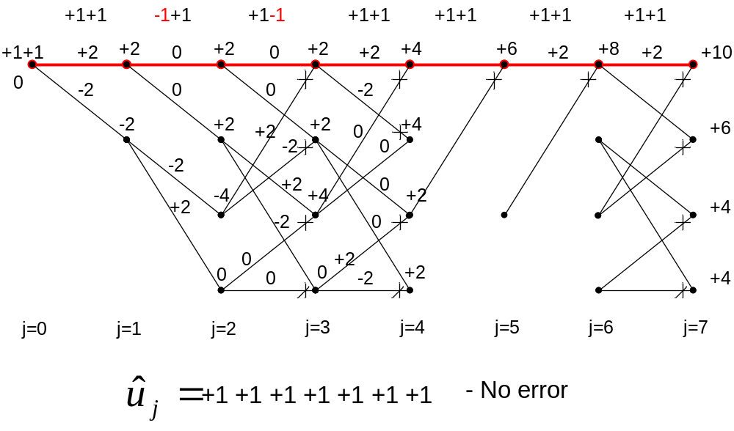

Slide 31
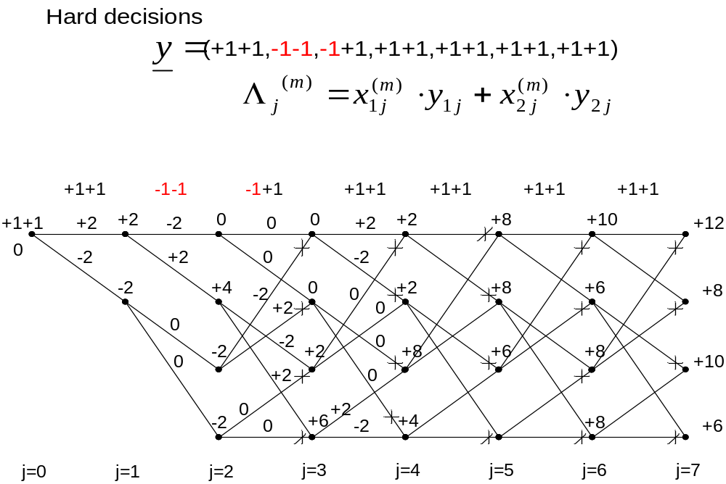

Slide 32
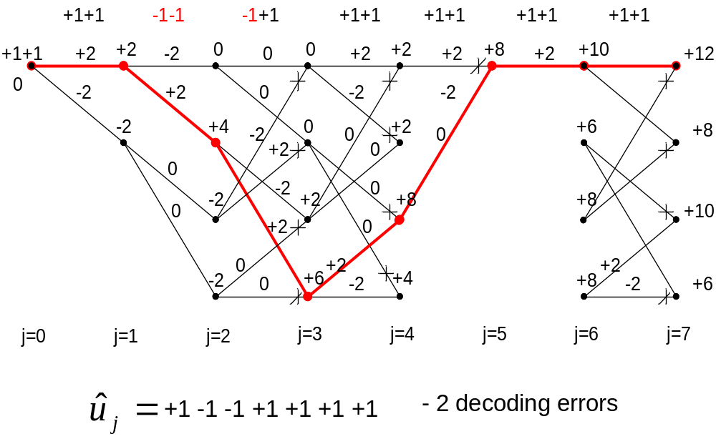

Slide 33
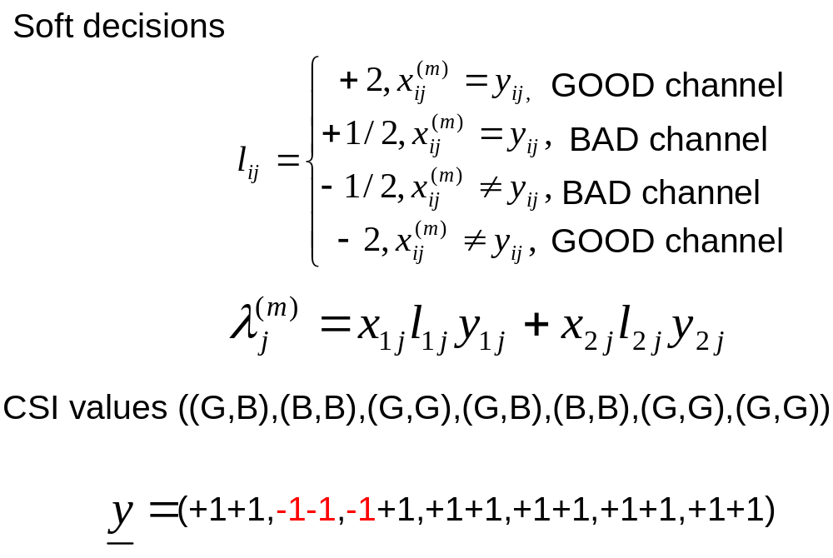

Slide 34
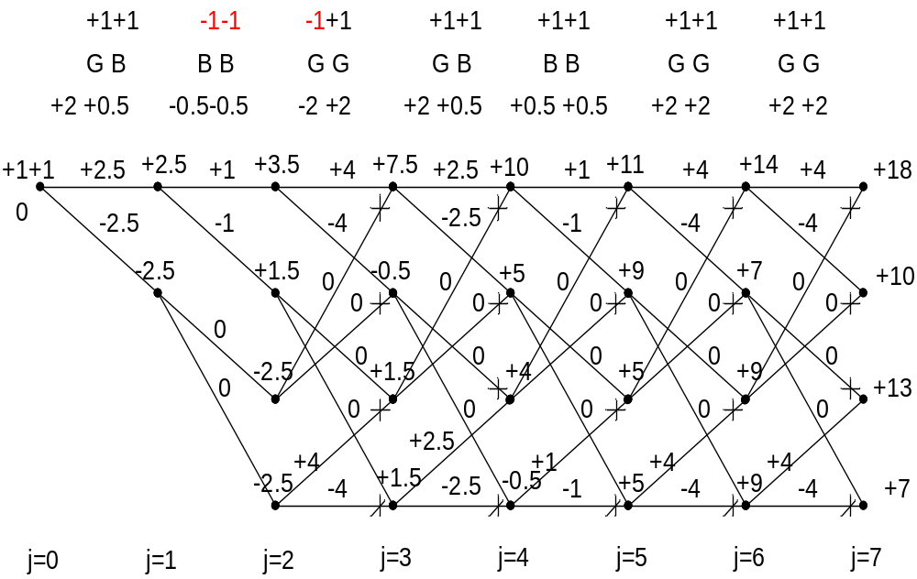

Slide 35
